Slide 1
design variables
Design-based estimation support in RDBES
WKRDB-INTRO 2024
Edvin Fuglebakk

Slide 2
Sampling design
Stratification, clustering, unequal probability
Statistical Efficiency: some parts of the population are important to cover well for low uncertainty in estimate
Cost efficiency: some parts of the population are more accessible or cheap to sample
Sampling design: controlled bias in sampling
Archiving design variables: flexibility in estimation methods

Slide 3
standardization
RDBES provides a standardized framework to describe sampling designs.
Sampling hierarchies (clustering)
Design variables: clustering, stratification, unequal probability sampling.

Slide 4
Design variables RDBES
On each sampling unit (level in hierarchy):
numberTotal
numberSampled
selectionProb
inclusionProb
selectionMethod
samplingUnitName
Stratification, stratum
Clustering, clusterName, selectionMethodCluster, numberTotalClusters, numberSampledClusters, selectionProbCluster, InclusionProbCluster
auxiliaryVariableTotal, auxiliaryVariableValue, auxiliaryVariableName, auxiliaryVariableUnit
sampled, reasonNotSampled, nonResponseCollected

Slide 5
ESTIMATION
Statistical inference
model based
design based
Frequentist
Bayesian
Assumptions on processes generating data (nature, sampling, etc.)
Assumptions on sampling

Slide 6
Design based estimation
Based on assumptions we can control:
Random selection with known probability
Bare minimum of what is needed for correct estimation
No assumptions on species or fishery, transferrable between contry and stock
Easy to share code

Slide 7
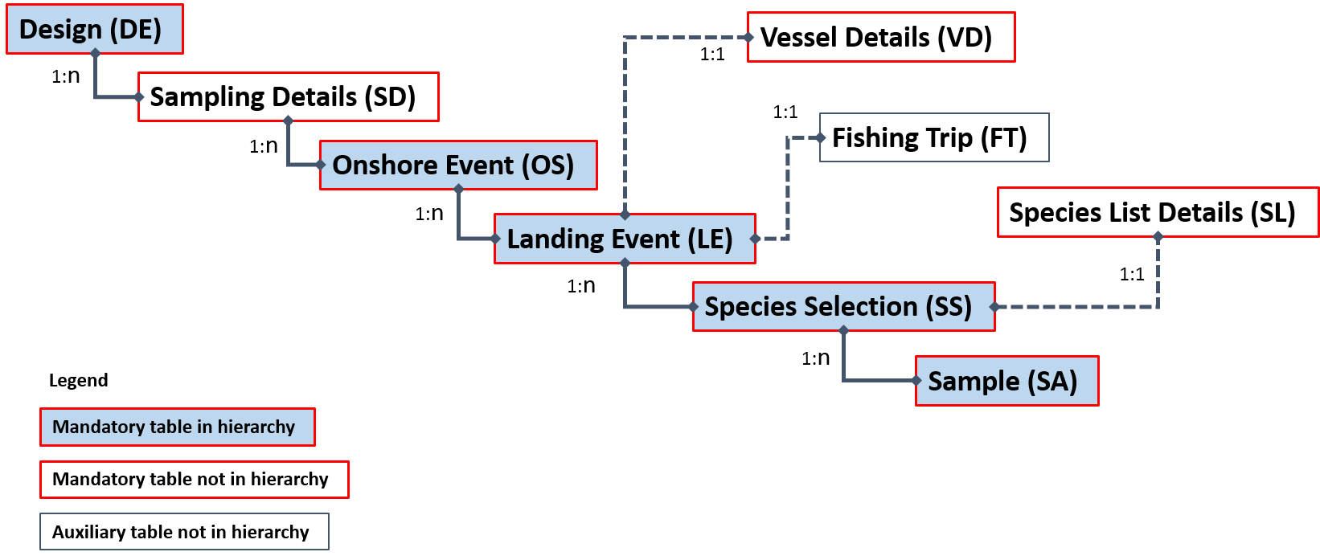
Sampling units (Hierarchies)
Hierarchical sampling imposes correlation structure in data
Reduces effective sample size.
Each table in a hiearchy represents a selection of sampling units.
Each table therefore have design variables

Slide 8
Design variables RDBES
On each sampling unit (level in hierarchy):
numberTotal
numberSampled
selectionProb
inclusionProb
selectionMethod
samplingUnitName
Stratification, stratum
Clustering, clusterName, selectionMethodCluster, numberTotalClusters, numberSampledClusters, selectionProbCluster, InclusionProbCluster
auxiliaryVariableTotal, auxiliaryVariableValue, auxiliaryVariableName, auxiliaryVariableUnit
sampled, reasonNotSampled, nonResponseCollected

Slide 9
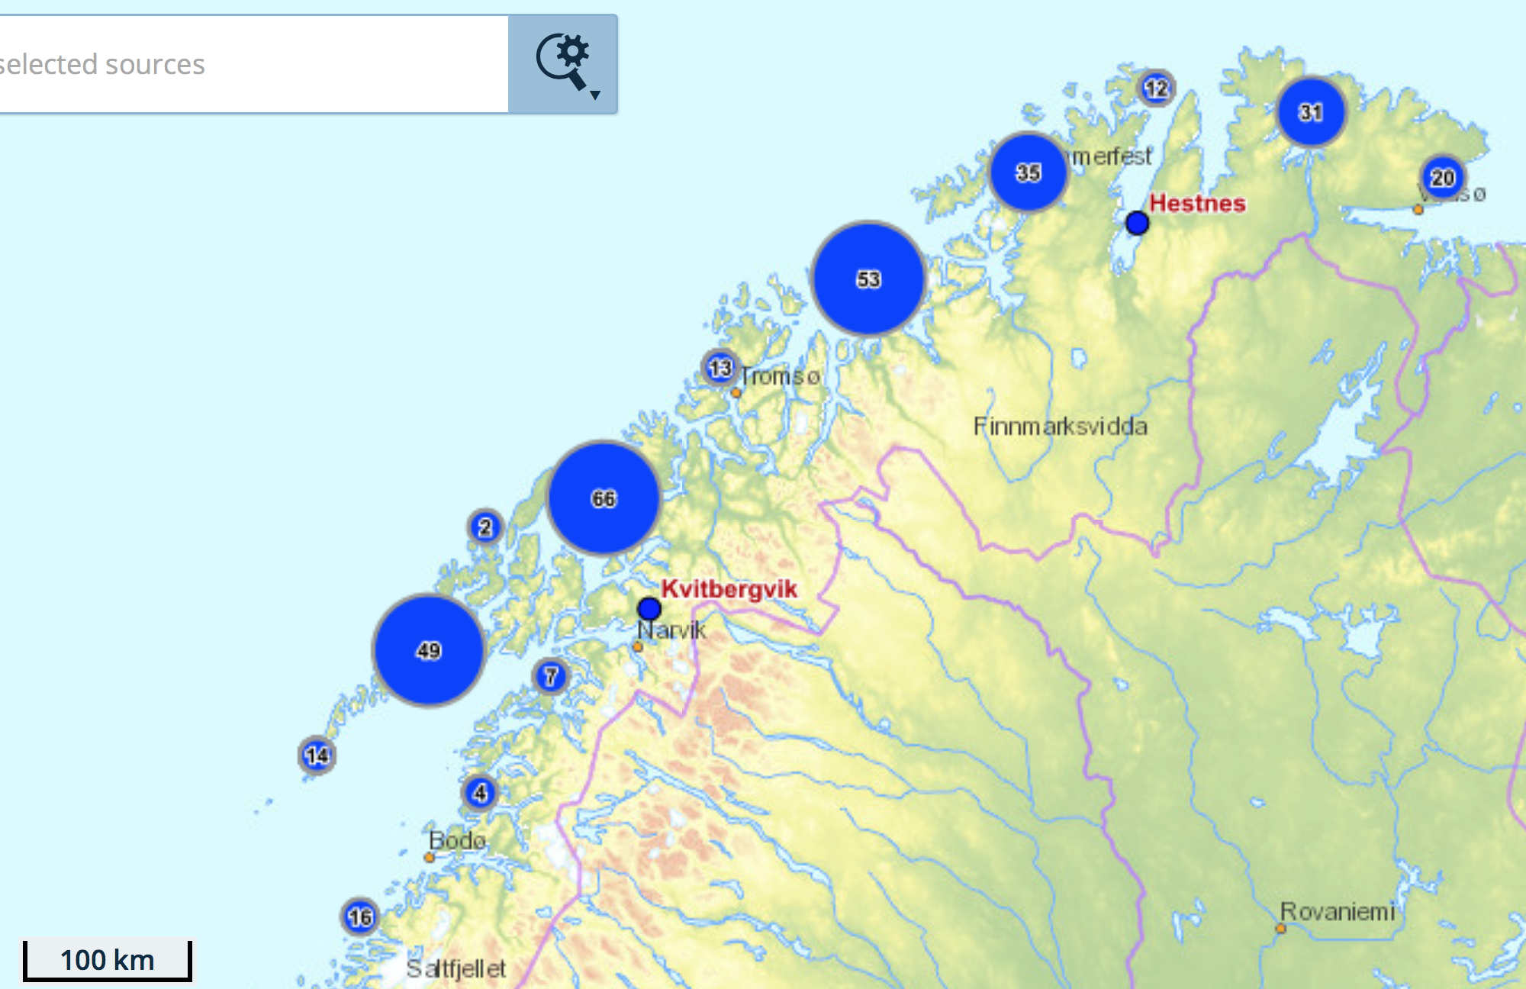
EXAMPLE
Hierarchy 5
PSU: Site-day
SSU: landing
PSUs:
Site 1, Jan 1
Site 2, Jan 1
...
Site 271, Dec 31

Slide 10
BASIC DESIGN VARIABLES
We always need:
Random selection with known probability (and known total number of sampling units in population).
numberTotal
numberSampled
selectionProb
inclusionProb
selectionMethod

Slide 11
EXAMPLE
Hierarchy 5
PSU: Site-day
SSU: landing
OSid | OSnationalLocationName | OSsamplingDate | OSnumberTotal | OSnumberSampled | OSSelectionProb | OSInclusionProb | OSselectionMethod
1 | Site 1 | Jan 1 | 98915 | 140 | 1.01097e-5 | 0.001415 | SRSWOR
2 | Site 70 | Feb 3 | 98915 | 140 | 1.01097e-5 | 0.001415 | SRSWOR
3 | Site 112 | Sep 16 | 98915 | 140 | 1.01098e-5 | 0.001415 | SRSWOR
PSUs:
Site 1, Jan 1
Site 2, Jan 1
...
Site 271, Dec 31

Slide 12
EXAMPLE
Hierarchy 5
PSU: Site-day
SSU: landing
PSUs:
Site 1, Jan 1
Site 2, Jan 1
...
Site 271, Dec 31

Slide 13
EXAMPLE
Hierarchy 5
PSU: Site-day
SSU: landing
OSid | OSnationalLocationName | OSsamplingDate | OSnumberTotal | OSnumberSampled | OSselectionMethod
1 | Site 1 | Jan 1 | 98915 | 140 | SRSWOR
2 | Site 70 | Feb 3 | 98915 | 140 | SRSWOR
3 | Site 112 | Sep 16 | 98915 | 140 | SRSWOR
PSUs:
Site 1, Jan 1
Site 2, Jan 1
...
Site 271, Dec 31
LEid | OSid | LEtotal | LEsampeld | LEselectionMethod
1 | 1 | 10 | 2 | SRSWOR
2 | 1 | 10 | 2 | SRSWOR
3 | 2 | 7 | 1 | SRSWOR

Slide 14
ZEROES
Need to record zeroes with design based estimation
Unlike ratio estimation and many model based estimations
Implemented with species selection level (Liz Clarke: presentation about true zeroes)

Slide 15
EXAMPLE
Hierarchy 5
PSU: Site-day
SSU: landing
OSid | OSnationalLocationName | OSsamplingDate | OSnumberTotal | OSnumberSampled | selectionMethod
1 | Site 1 | Jan 1 | 98915 | 140 | SRSWOR
2 | Site 70 | Feb 3 | 98915 | 140 | SRSWOR
3 | Site 112 | Sep 16 | 98915 | 140 | SRSWOR
4 | Site 9 | Dec 25 | 98915 | 140 | SRSWOR
PSUs:
Site 1, Jan 1
Site 2, Jan 1
...
Site 271, Dec 31
LEid | OSid | LEtotal | LEsampeld | LEselectionMethod
1 | 1 | 10 | 2 | SRSWOR
2 | 1 | 10 | 2 | SRSWOR
3 | 2 | 7 | 1 | SRSWOR
4 | 4 | 0 | 0 | SRSWOR

Slide 16
stratification
Sampling Strata: partitioning of the sampling frame
Every sampling unit in the population belong to exactly one strata
We know the population total in each strata
May reduce variance in estimate, does not affect bias in design based estimation
Many possibilites, need flexible system
Text strings controlled by submitter, rather than reference list

Slide 17
EXAMPLE
LEid | OSid | LEtotal | LEsampeld | LEselectionMethod
1 | 1 | 10 | 2 | SRSWOR
2 | 1 | 10 | 2 | SRSWOR
3 | 2 | 7 | 1 | SRSWOR
LEid | OSid | LEstratification | LEstratum | LEtotal | LEsampeld | LEselectionMethod
1 | 1 | Yes | Gillnet | 6 | 1 | SRSWOR
1 | 1 | Yes | Longline | 3 | 1 | SRSWOR
1 | 1 | Yes | D. Seine | 1 | 0 | SRSWOR

Slide 18
CLUSTERING
Clusters of some sampling unit
Actually another level in the hiearchy
Many possibilites, need flexible system (like stratification)
Text strings controlled by submitter, rather than reference list
No separate table, noted on the sampling unit that are being clustered

Slide 19
EXAMPLE

Slide 20
EXAMPLE
Region 4
Region 3
Hierarchy 5 w clustering
PSU: Region-weeks
SSU: Site-day
TSU: landing
Region 2
Region 1
PSUs:
Region 1, Week 1
Region 2, Week 1
...
Region 4, Week 52

Slide 21
EXAMPLE
Region 4
Region 3
Hierarchy 5 w clustering
PSU: Region-weeks
SSU: Site-day
TSU: landing
Cluster 2
OSid | OSnationalLocationName | OSsamplingDate | OSnumberTotal | OSnumberSampled | selectionMethod
1 | Site 1 | Jan 1 | 623 | 7 | SRSWOR
2 | Site 5 | Jan 2 | 623 | 7 | SRSWOR
3 | Site 112 | Sep 16 | 574 | 7 | SRSWOR
Cluster 1
PSUs:
Region 1, Week 1
Region 2, Week 1
...
Region 4, Week 52
OSclustering | OSclusterName | OStotalClusters | OSsampledClusters | OSSelectionProbCluster | OSInclusionProbCluster | OSselectionMethodCluster
2-stage | Region1/W1 | 208 | 20 |  |  | SRSWOR
2-stage | Region1/W1 | 208 | 20 |  |  | SRSWOR
2-stage | Region2/W38 | 208 | 20 |  |  | SRSWOR

Slide 22
UNEQUAL PROBABILITY
We always need (for unbiased estimate):
Random selection with known probability and known total number of sampling units in population.
Distribution of sampling effort may reduce variance in estimate
Can be controlled by unequal probability sampling

Slide 23
EXAMPLE
Region 4
0.27%
Region 3
0.27%
Hierarchy 5 w clustering
PSU: Region-weeks
SSU: Site-day
TSU: landing
Region 2
0.27%
Region 1
3%/w Jan-April
0.27% May-Dec
PSUs:
Region 1, Week 1
Region 2, Week 1
...
Region 4, Week 52

Slide 24
EXAMPLE
Region 4
0.27%
Region 3
0.27%
Hierarchy 5 w clustering
PSU: Region-weeks
SSU: Site-day
TSU: landing
Cluster 2
0.27%
OSid | OSnationalLocationName | OSsamplingDate | OSnumberTotal | OSnumberSampled | selectionMethod
1 | Site 1 | Jan 1 | 623 | 7 | SRSWOR
2 | Site 5 | Jan 2 | 623 | 7 | SRSWOR
3 | Site 112 | Sep 16 | 574 | 7 | SRSWOR
Cluster 1
3%/w Jan-April
0.27% May-Dec
PSUs:
Region 1, Week 1
Region 2, Week 1
...
Region 4, Week 52
OSclustering | OSclusterName | OStotalClusters | OSsampledClusters | OSincProbCluster | OSselectionMethodCluster
2-stage | Region1/W1 | 208 | 20 | 0.3 | UPSWOR
2-stage | Region1/W1 | 208 | 20 | 0.3 | UPSWOR
2-stage | Region2/W38 | 208 | 20 | 0.027 | UPSWOR

Slide 25
Desing based ratio estimation
Ratio-estimation
typically somewhat biased
Utilizes more exact values, less error
May depend on auxiliary variables not provided in RDBES.
E.g. total weight of target species for discard estimation
RDBES support one aux variable at each level:
auxiliaryVariableTotal, auxiliaryVariableValue, auxiliaryVariableName, auxiliaryVariableUnit

Slide 26
Implementation of design
Does not always go according to plan
Need to record deviations from design
Can record reason for not sampling

Slide 27
EXAMPLE
OSid | OSnationalLocationName | OSsamplingDate | OSnumberTotal | OSnumberSampled | selectionMethod
1 | Site 1 | Jan 1 | 98915 | 140 | SRSWOR
2 | Site 70 | Feb 3 | 98915 | 140 | SRSWOR
3 | Site 112 | Sep 16 | 98915 | 140 | SRSWOR
4 | Site 9 | Dec 25 | 98915 | 140 | SRSWOR
Hierarchy 5
PSU: Site-day
SSU: landing
PSUs:
Site 1, Jan 1
Site 2, Jan 1
...
Site 271, Dec 31
LEid | OSid | LEnumberTotal | LEnumberSampled | LEselectionMethod | LEnoSampReason
1 | 1 | 10 | 2 | SRSWOR
2 | 1 | 10 | 2 | SRSWOR
3 | 2 | 7 | 1 | SRSWOR
4 | 4 | 3 | 0 | SRSWOR | Non-response – sampling Error

Slide 28
Pragmatic design
Probabilistic designs are not always practical
Logistics, Regulation, Cost
→ pragmatic designs.
Hierarchies, clustering and stratification need to be identified for all kinds of estimations.
Selection methods inform on how to do estimation:
Post-stratification
Model-assumptions
Purpose of sampling

Slide 29
EXAMPLE
OSid | OSnationalLocationName | OSsamplingDate | OSnumberTotal | OSnumberSampled | selectionMethod
1 | Site 1 | Jan 1 |  | 140 | NPCS
2 | Site 70 | Feb 3 |  | 140 | NPCS
3 | Site 112 | Sep 16 |  | 140 | NPCS
4 | Site 9 | Dec 25 |  | 140 | NPCS
Hierarchy 5
PSU: Site-day
SSU: landing
PSUs:
Site 1, Jan 1
Site 2, Jan 1
...
Site 271, Dec 31
LEid | OSid | LEnumberTotal | LEnumberSampled | LEselectionMethod | LEnoSampReason
1 | 1 | 10 | 2 | SRSWOR
2 | 1 | 10 | 2 | SRSWOR
3 | 2 | 7 | 1 | SRSWOR

Slide 30
NONPROB Selection methods
Non-Probabilistic Quasi Simple Random Sampling (NPQSRSWOR, NPQSRSWR, NPQSYSS)
Non-Probabilistic Judgement Sampling (NPJS)
Cross-Level Quota Sampling (NPCLQS-T, NPCLQS-O)
Fixed Sample (FIXED)
Non-Probabilistic Convenience Sampling (NPCS)
There is always an element of convenience
Decision on code is subjective and with a purpose in mind

Slide 31
The battle against convenience
Non-probabilistic sampling:
Biased selection
Probabilistic sampling:
Biased response
There is (almost) no point exchanging non-probability schemes for low response rate.

Slide 32
The battle against convenience
Stratification / Clustering
For convenience sampling: May reduce bias May increase variance

Slide 33
The battle against convenience
Controlled selection:
Non-Probabilistic Judgement Sampling (NPJS)
Cross-Level Quota Sampling (NPCLQS-T, NPCLQS-O)
Fixed Sample (FIXED)
Natural randomization (all sampling units are convenient):
Non-Probabilistic Quasi Simple Random Sampling (NPQSRSWOR ... )

Slide 34
Norwegian port sampling no 64N
Norwegian port sampling no 64N is a pragmatic sampling program for which we can records approximate design parameters:
Hierarchies identified
Sampling frame and zero samples can be identified post-hoc from sales notes.

Slide 35
EXAMPLE
Day trips no 64N
Contact vessels at sea
Agree to meet at landing site
Sample at landing site before sale
Day trips no 64N
Contact landing site
Agree to sample incoming vessels
Sample at landing site after sale

Slide 36
EXAMPLE
DEid | DErecordType | DEsamplingScheme | DEyear | DEstratum | DEhierarchyCorrect | DEhierarchy
1 | DE | Norway IMR port-sampling | 2016 | Fresh/COD-POL-HAD/N64 | Yes | 5

Slide 37
EXAMPLE
OSid | OSnationalLocationName | OSsamplingDate | OSnumberTotal | OSnumberSampled | OSselectionMethod | OSstratidication | OSstratum
1 | Site 1 | Jan 1 | 9062 | 40 | NPJS | Yes | Q1
2 | Site 70 | Feb 3 | 9062 | 40 | NPJS | Yes | Q1

Slide 38
EXAMPLE
LEid | OSid | LEstratification | LEstratum | LEnumberTotal | LEnumberSampled | LEselectionMethod
1 | 1 | Yes | Gillnet | 6 | 1 | NPQSRSWOR
1 | 1 | Yes | Longline | 3 | 1 | NPQSRSWOR
1 | 1 | Yes | D. Seine | 1 | 0 | NPQSRSWOR

